Slide 1
Counting What Counts
WELS National Conference on Lutheran Leadership

Slide 2


Slide 3


Slide 4
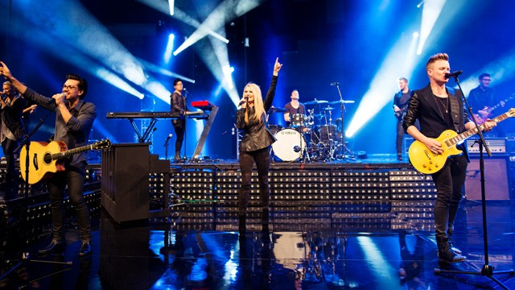


Slide 5
1 Corinthians 12:3"Therefore I want you to know that no one who is speaking by the Spirit of God says, 'Jesus be cursed,' and no one can say, 'Jesus is Lord,' except by the Holy Spirit”.

Slide 6

1 Corinthians 3:6 - I planted the seed, Apollos watered it, but God has been making it grow.

Slide 7
Give the Holy Spirit
the best product to bless.

Slide 8


Slide 9

Setting a Target
Creating a Plan to Get There
Faithfully Executing It

Slide 10
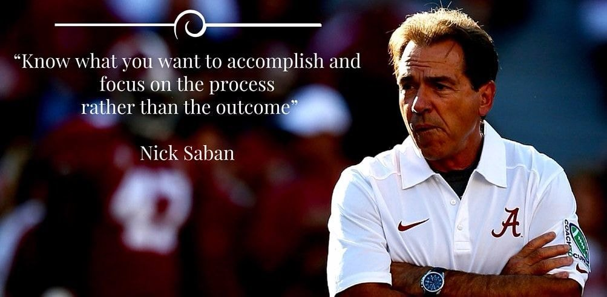

Slide 12
Process

Slide 13
Why an EOS?
It Keeps you Organized and Documented
It Keeps you Focused
It Makes you State your Goals Out Loud and in Writing
It Move the Abstract to Concrete

Slide 14
Process
Goals

Slide 15
Leaders Have Goals
Specific
Measurable
Time Stamped
Actionable

Slide 16
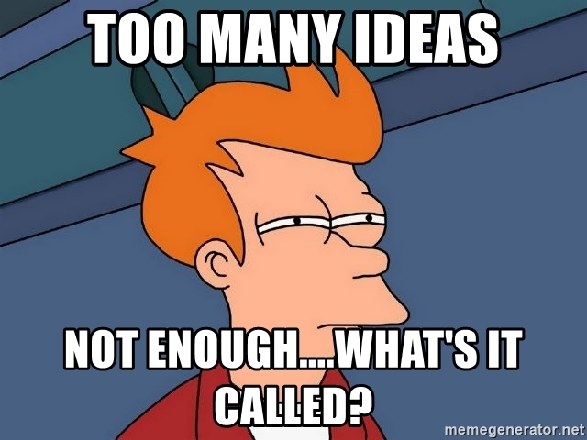

Slide 17
A Mission Statement is Not a Goal
Mission Statement
Fundamental Purpose
Why You Exist
Broad
Enduring
Goals
Specific
Measurable
Time Stamped
Actionable
Divine Savior Church changes lives with Jesus by providing opportunities to worship, connect, and serve in a Christ-centered environment.

Slide 18
Process
Goals
Strategy

Slide 19
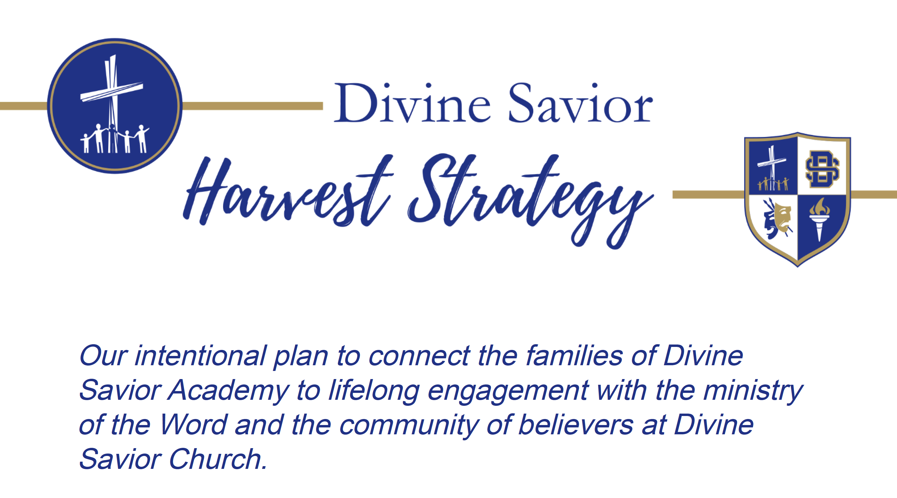
Notes:
This document outlines Divine Savior's comprehensive "Harvest Strategy" to foster lifelong engagement between Divine Savior Academy (DSA) and DSS! families and Divine Savior Church (DSC). The strategy emphasizes building genuine relationships, making personal invitations to church events and worship, and leveraging spiritual life surveys to tailor outreach. It details the specific roles of school staff as "missionary teachers", church staff in equipping and encouraging, and church members in hospitality and relationship building, all working collaboratively to share the gospel and integrate families into the church community through various events and follow-up processes. The overarching goal is to connect individuals to Christ for life and ensure continuous spiritual growth beyond initial attendance. Out attitude? We desire life-long life in Christ… so that people become disciples who make disciples.

Slide 20
Why a Harvest the School?
Time...Lots of It
Built in Trust and Relationships
Constant Contact
Manpower

Slide 21
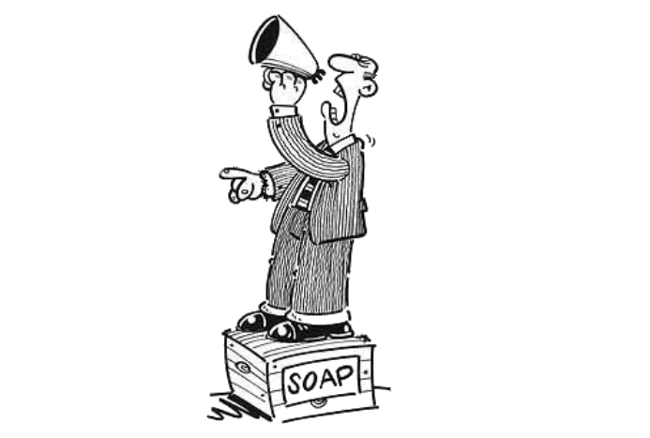
An Amazing Opportunity

Slide 22
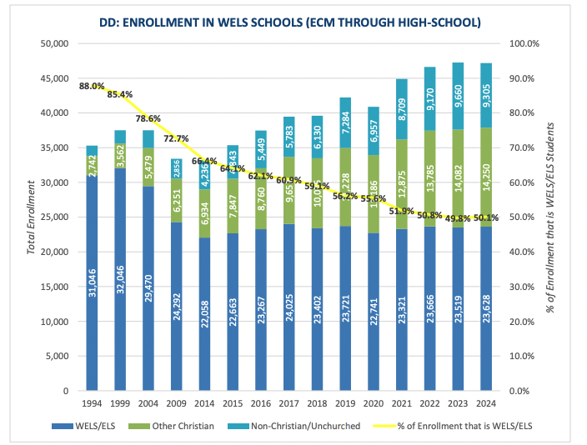

Slide 23

An Amazing Opportunity

Slide 24
Notes:
This document outlines Divine Savior's comprehensive "Harvest Strategy" to foster lifelong engagement between Divine Savior Academy (DSA) and DSS! families and Divine Savior Church (DSC). The strategy emphasizes building genuine relationships, making personal invitations to church events and worship, and leveraging spiritual life surveys to tailor outreach. It details the specific roles of school staff as "missionary teachers", church staff in equipping and encouraging, and church members in hospitality and relationship building, all working collaboratively to share the gospel and integrate families into the church community through various events and follow-up processes. The overarching goal is to connect individuals to Christ for life and ensure continuous spiritual growth beyond initial attendance. Out attitude? We desire life-long life in Christ… so that people become disciples who make disciples.

Slide 25
Harvest Strategy
We Are All In
Get to Know Your People – Spiritual Life Survey

Slide 26
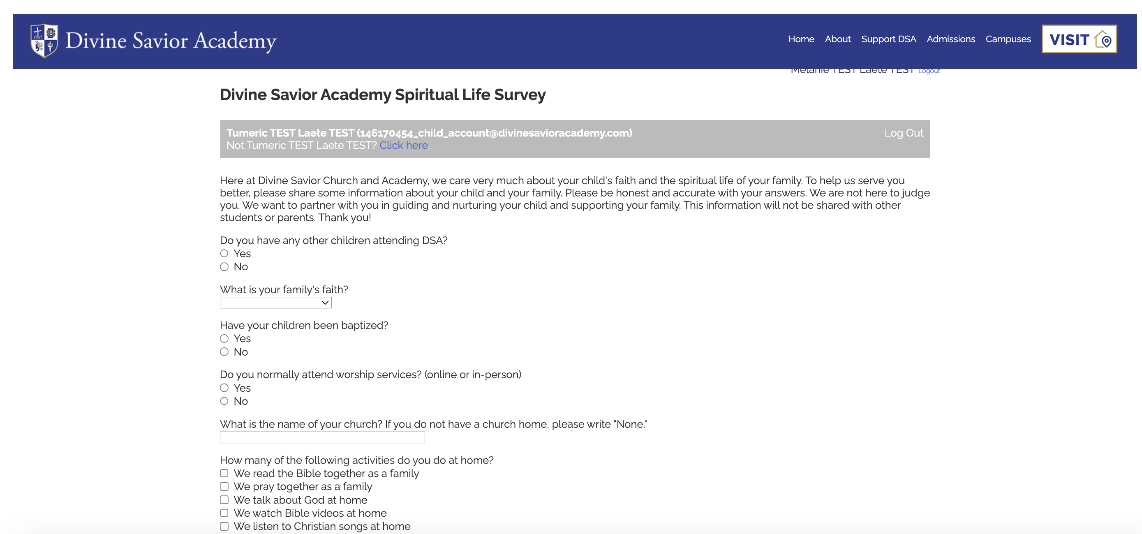
Notes:
The base layer of our strategy is the use of our Spiritual Life Surveys, completed by every family for every student enrolled at DSA on every campus. We can access this info now mid-summer to prepare targeted communications for the coming school year based on it. The questions we ask have helped us develop programs and classes designed to meet the needs of various groups. Such as….

Slide 27









Unchurched
Students
272
Unchurched
112
Students
1160
Unchurched
480
Unchurched By
Worship Attendance
< 2X month
41%
41%
Delray Beach
Doral
Students
371
Unchurched
131
Students
426
Unchurched
144
Students
167
Unchurched
122
34%
35%
73%
Santa Rita Ranch
Sienna
Grenada
Notes:
Purple represents unchurched. Here this is 989 students out of 2,396. We have determined unchurched is those who declare no church + those who say they attend occasionally or less than twice a month, meaning once a month of less. We noticed that the spiritual habits / practices like praying at home, reading the Bible, etc. were essentially no different from those who nominally said they attend church occasionally and those who declared they have no church. We are further convinced that there are many who simply overstate their Christian faith commitments simply because they know that school enrollment can be competitive and they imagine that by “Putting their best foot forward” they will be more likely to get enrolled.

Slide 29

No Church Listed
Of 601 students (25% of all DSA)
that didn’t list a church...
01
02
54%
58%
Said Yes To Receving Info
About The
Church
Said Yes To Learning
About The
Bible

Slide 30
Nominal Church Attendance
Of 989 students (41% of all DSA)
that attend church less 2x a month...
01
02
56%
58%
Said Yes To Receving Info
About The
Church
Said Yes To Learning
About The
Bible
Notes:
554 on day one are inviting us to reach out to them! We have ~1,000 unchurched students across our campuses!

Slide 31
Not Baptized
Of 818 students (34% of all DSA)
that are not baptized...
01
02
11%
Said They Are Interested in Baptism
Notes:
82 students are asking us to reach out to them about getting baptized on day one!

Slide 32
Harvest Strategy
We Are All In
Get to Know Your People – Spiritual Life Survey
Use the Information to Drive Your Strategy

Slide 33
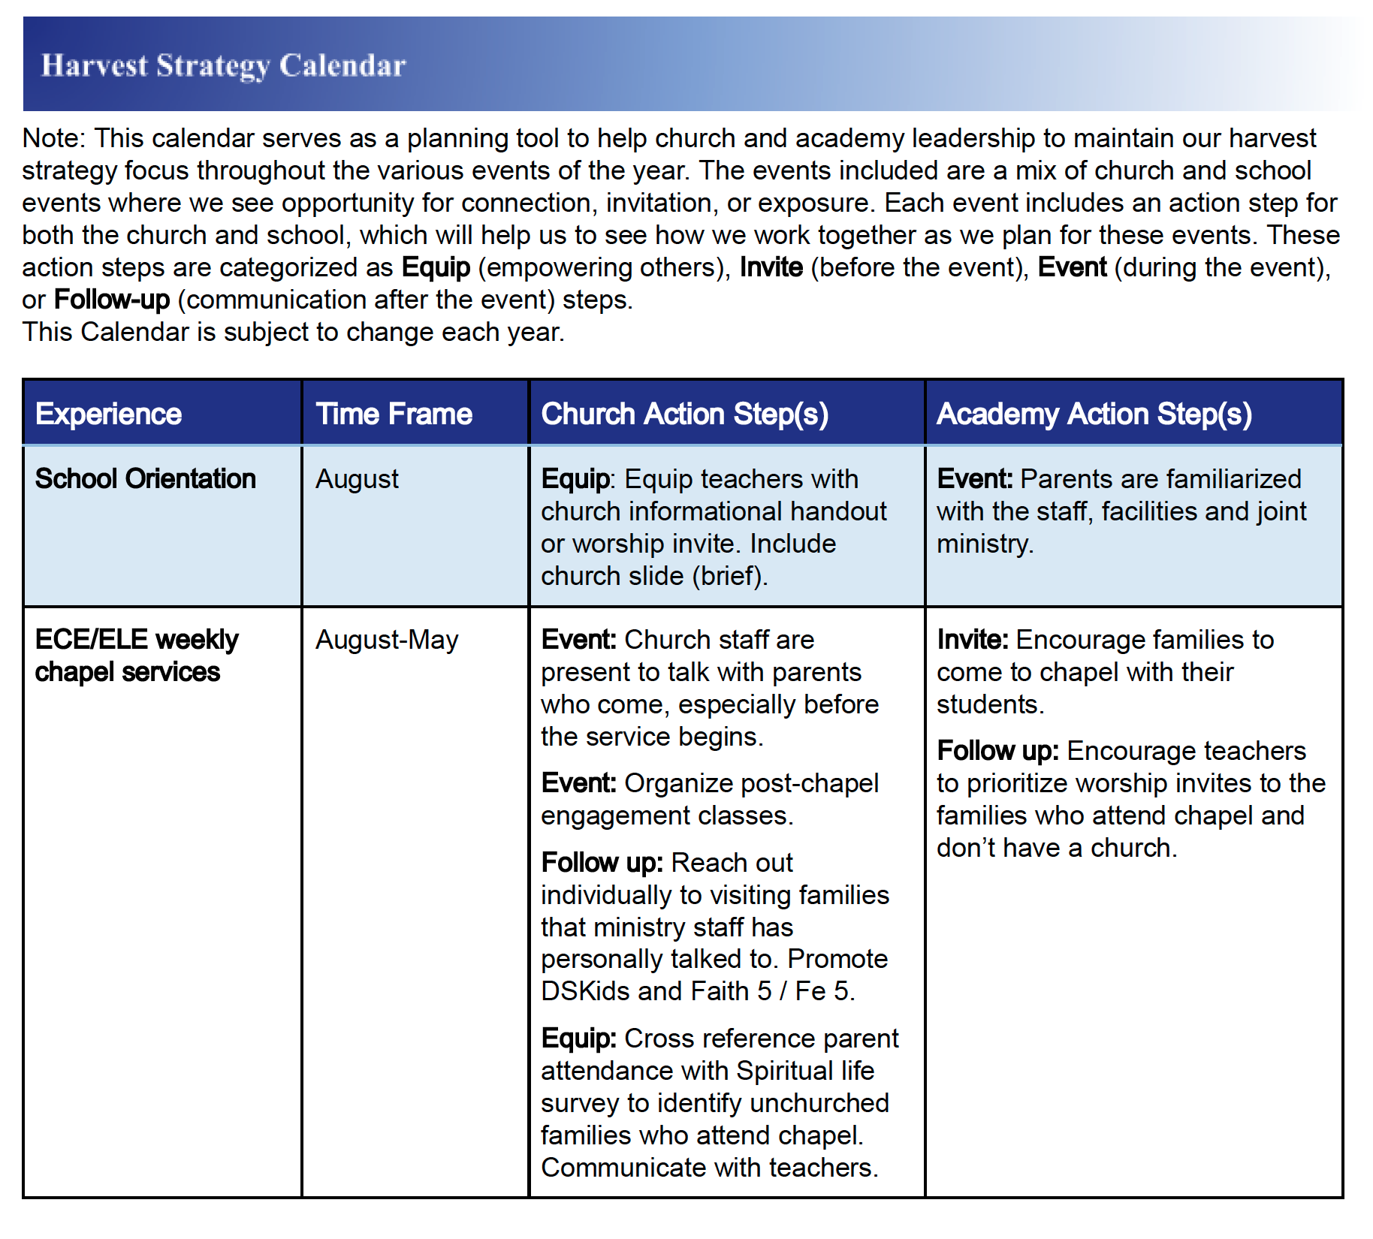
Notes:
Harvest Strategy Calendar: You will fill this in on your campus and your leveled leader will help you see what’s coming next and what to communicate. Will also encourage and discuss at leveled meetings.

Slide 34
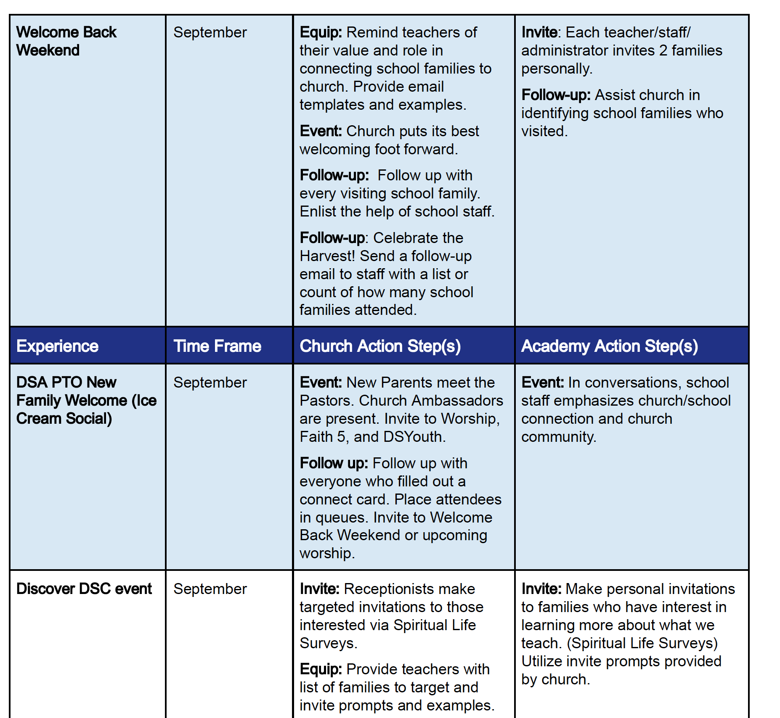

Slide 35
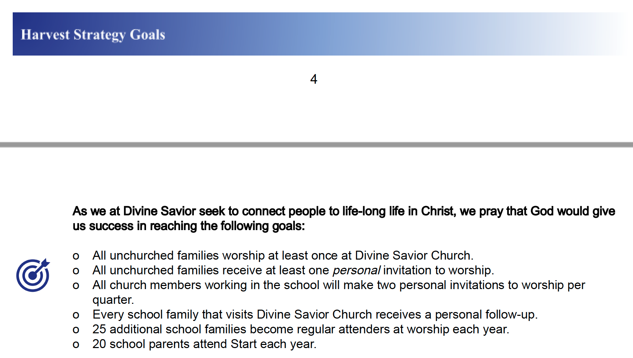
Notes:
In their time enrolled in school: for a special service, because kids’ sing, etc.
One personal invitation to worship per year: not a mass invite
If you look at the # of unchurched per campus and we want to cover everyone, it would look like this… you making two personal invitations to worship per quarter.
We have a system and a Follow-Up process on each campus that ensures everyone receives at least four personal contacts trying to draw them into the adult discipleship path.

Slide 36
Harvest Strategy
We Are All In
Get to Know Your People – Spiritual Life Survey
Use the Information to Drive Your Strategy
Make the Information Available

Slide 37
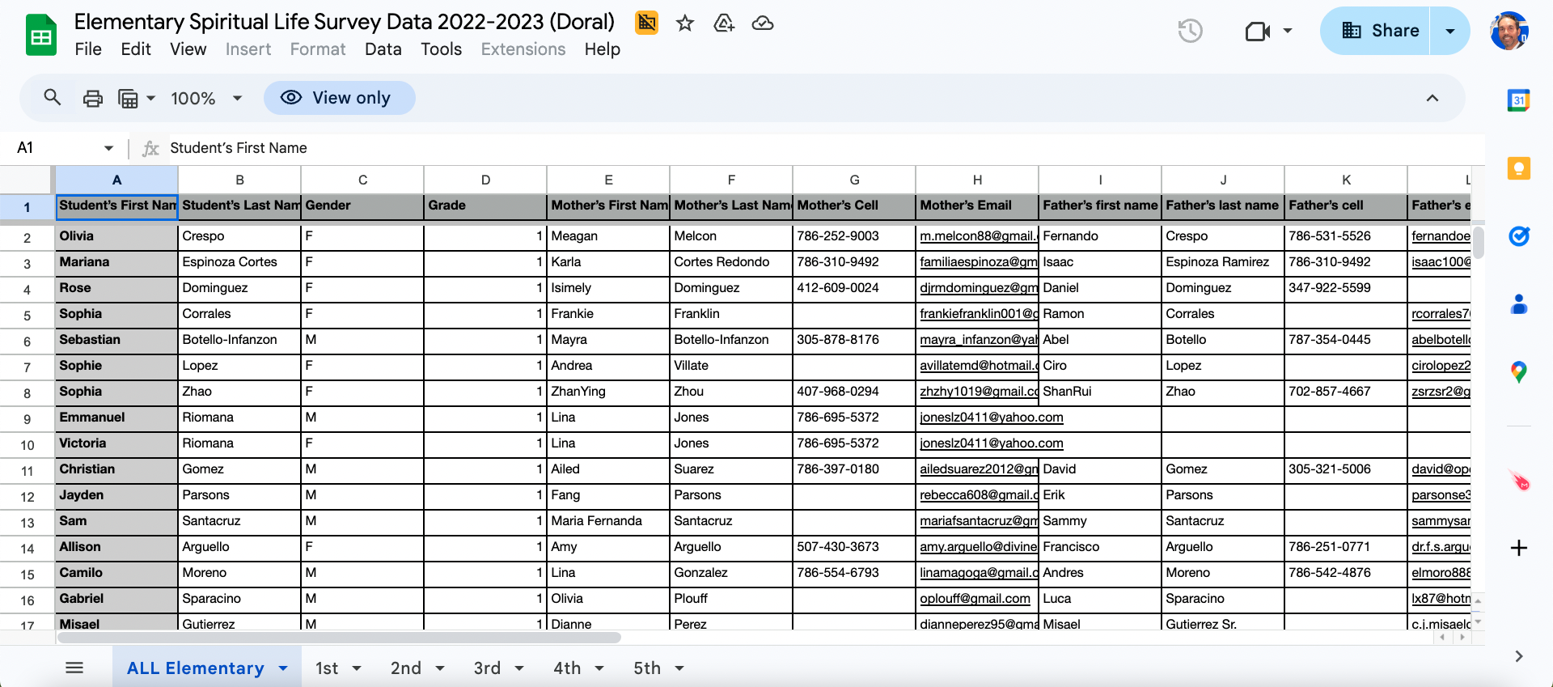
Notes:
The base layer of our strategy is the use of our Spiritual Life Surveys, completed by every family for every student enrolled at DSA on every campus. We can access this info now mid-summer to prepare targeted communications for the coming school year based on it. The questions we ask have helped us develop programs and classes designed to meet the needs of various groups. Such as….

Slide 38
Harvest Strategy
We Are All In
Get to Know Your People – Spiritual Life Survey
Use the Information to Drive Your Strategy
Make the Information Available
Start Harvesting

Slide 39
Notes:
In their time enrolled in school: for a special service, because kids’ sing, etc.
One personal invitation to worship per year: not a mass invite
If you look at the # of unchurched per campus and we want to cover everyone, it would look like this… you making two personal invitations to worship per quarter.
We have a system and a Follow-Up process on each campus that ensures everyone receives at least four personal contacts trying to draw them into the adult discipleship path.

Slide 40

Notes:
Faith5 provides a powerful framework to deeply connect your family to God and to each other. This simple, easy to implement faith practice is perfect for incorporating into a daily / nightly routine in five to fifteen minutes a day/night. When done over time, FAITH 5 has the power to bring the family together through sharing highs and lows, Scripture, talk, prayer, and blessings. Pat Hurley who’s here is a champion of this for our DSC A.

Slide 41

Notes:
DSC facilitates communication by creating tools to make these easy invites like postcards for parent / teacher conferences, email templates, etc

Slide 42
Harvest Strategy
We Are All In
Get to Know Your People – Spiritual Life Survey
Make the Information Available
Use the Information to Drive Your Strategy
Start Harvesting
Celebrate the Wins

Slide 43
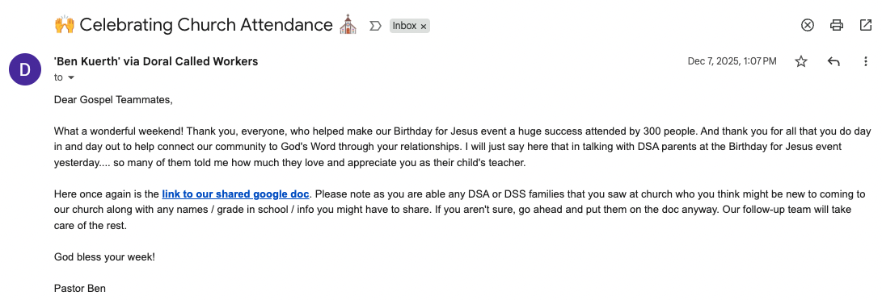

Slide 44
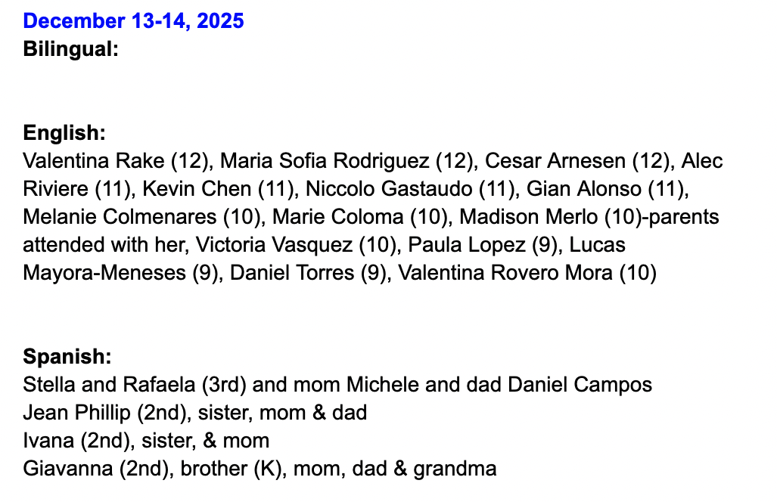

Slide 45
Adult Confirmations and Baptisms
Notes:
These stats represent last school year (July 1, 2024-June 30, 2025). Profession of faith and unity with us based on Bible study in Youth Confirmation classes taught by pastors or Adult Discipleship Path Courses – Discover, Start, and Grow.

Slide 46
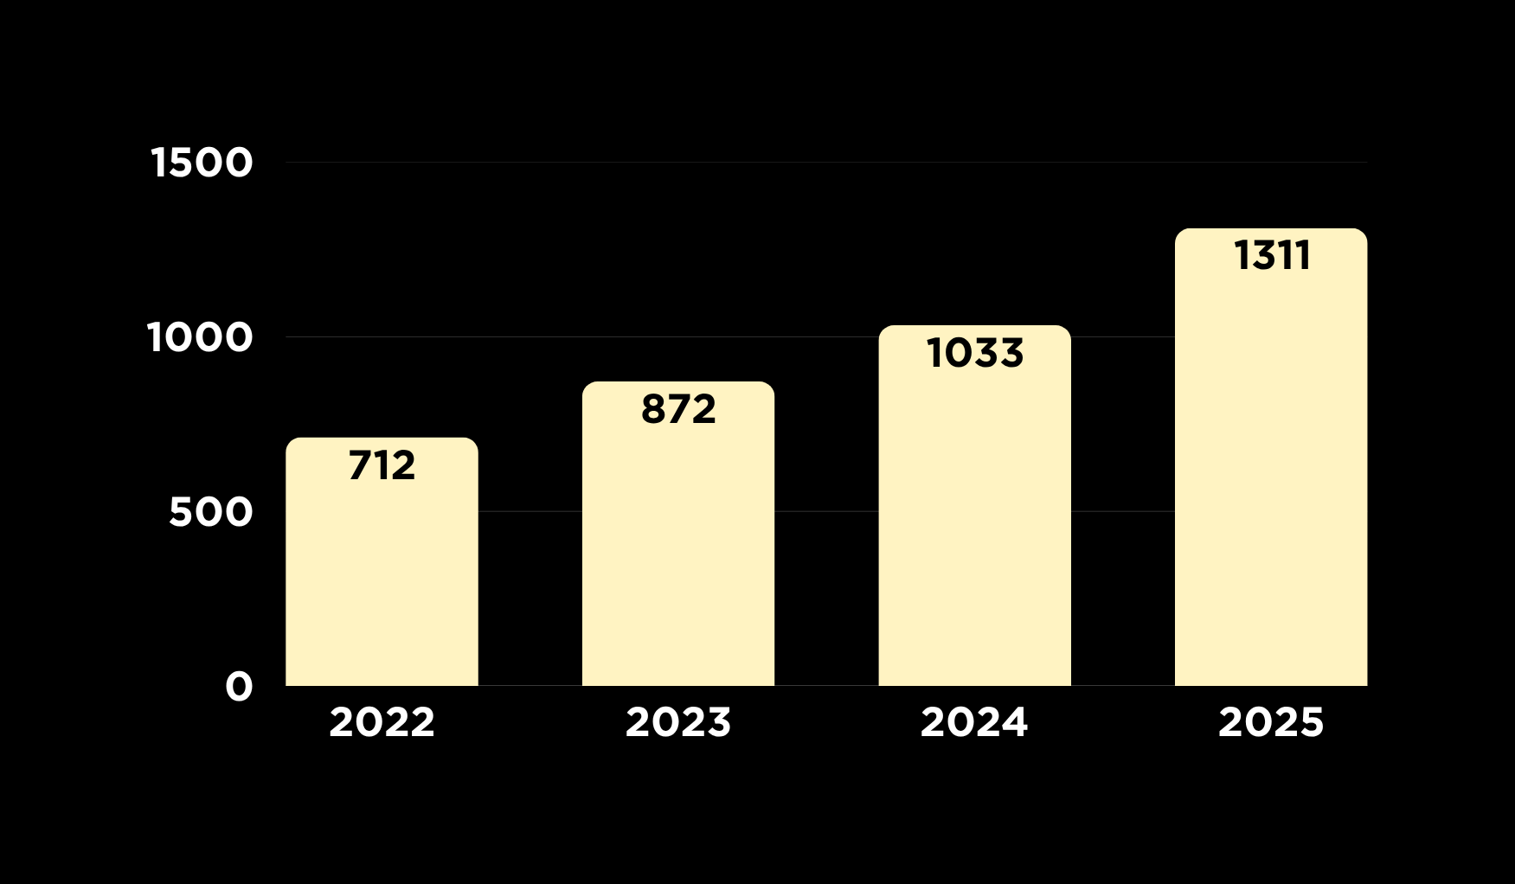

Average Worship Attendance
Target
for
2025
Notes:
God has been blessing us with steady growth and we in faith have goals we pray God will continue to bless.

Slide 47
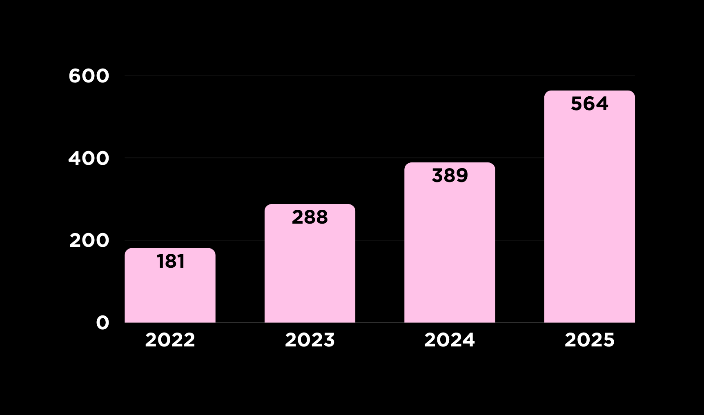

Average Growing in the Word
Target
for
2025
Notes:
Bible studies, Connect Groups, and Discipleship Path courses like Start and Grow

Slide 48

Tracking Engagement
Youth Discipleship Leaders
Adult Discipleship Leaders
Notes:
This is adult confirmations. These goals help support the grow in worship attendance and Bible studies.

Slide 49
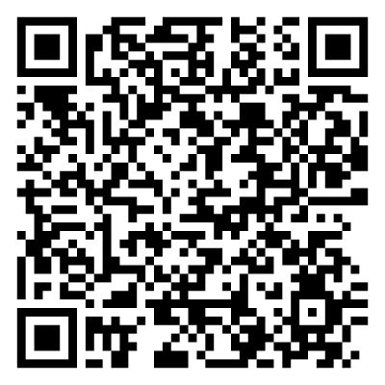

Harvest Strategy Deep Dive
Notes:
17:07 Start Used Google LM to create a podcast based on all our Harvest Strategy documents and presentations.

Slide 50
Accountability

Slide 51
Harvest Strategy Deep Dive
Notes:
17:07 Start Used Google LM to create a podcast based on all our Harvest Strategy documents and presentations.

